Slide 1
Preliminary Design Review
Team 24
“Remote Chessboard”
October 20, 2017
Notes:
‹#›
‹#›
‹#›

Slide 2
Team Introduction
Battsooj Bayarsaikhan
Shashwat Patel
David Nguyen

Slide 3
Content
Problem Statement
System Specifications
Design Alternatives
Block Diagram
Budget

Slide 4
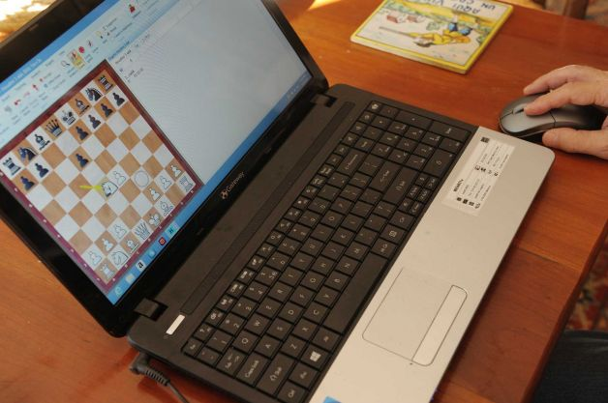
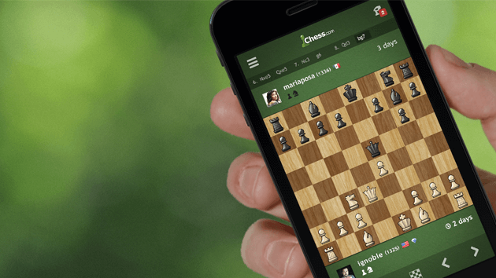
Problem Statement
Digitization of Entertainment
interconnected
convenient
less holistic experience
Chess.com
18 million+ members
Goal
To create a chessboard that allows users to play remotely while providing a more intimate experience

Slide 5
System Requirement
An ideal system/solution must possess the following characteristics:
Detect every move/changes on the board accurately
Identify different types of pieces
Verify eligibility of recorded move
Indicate illegal moves
Fast response time (<2s)
Standard sized (5cm-6cm squares) (3.75in king height)
Reflect opponent’s move clearly

Slide 6
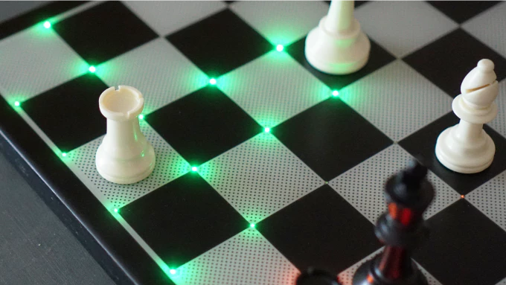
Design Alternatives 1
Chesstronic Smart Chess Board (Kickstarter)
This project was launched on July 21, 2017, and was cancelled due to underfunding.
- Similar User Interface (moves are indicated with LEDs)
- Lacks in Detecting Individual Pieces (No RFID readers)
Assumes every piece is placed in the right locations in the beginning of games.
Requires to use the app frequently during game for the special moves (Castling, Pawn Promotion, En Passant).
Therefore defeats the purpose of the project which is physical intimate experience.
https://www.kickstarter.com/projects/14758633/chesstronic-smart-chess-board/description

Slide 7
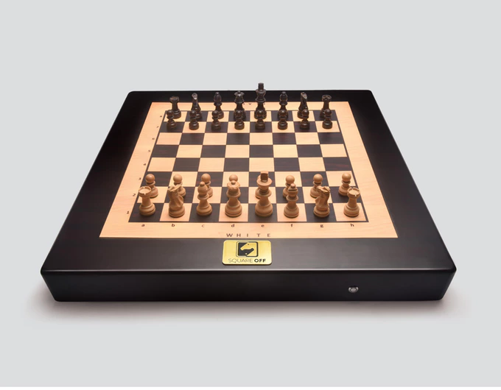
Design Alternatives 2
Square-Off (Kickstarter)
This project was launched on Nov 5, 2016 and funded.
- Completely Different User Interface (with self moving parts and no LEDs)
- Lacks in Detecting Individual Pieces (No RFID readers)
Assumes every piece is placed in the right locations in the beginning of games.
Requires to use the app frequently during game for the special moves (Castling, Pawn Promotion, En Passant). Therefore defeats the purpose of the project which is physical intimate experience.
Uses pressure sensors to detect the movements (players have to press hard on the board
Uses smaller pieces than standardized size to make the movements
https://www.kickstarter.com/projects/infivention/square-off-worlds-smartest-chess-board-relaunched

Slide 8
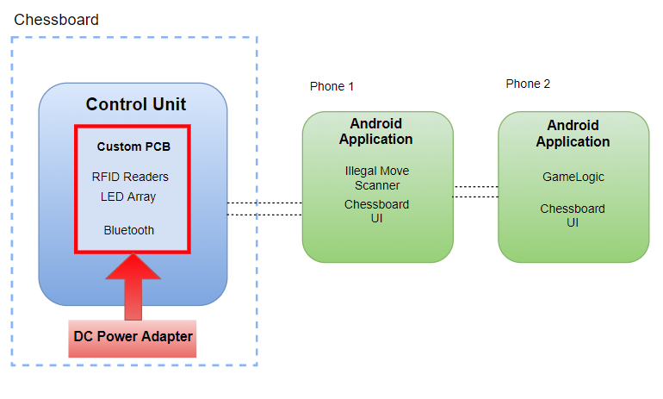
Our Design

Slide 9
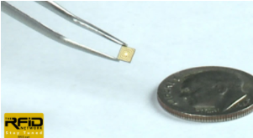
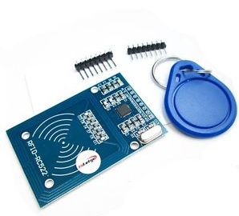
RFID Sensing System
ARPT System
Passive Tags
LF/HF
Lowest radio interference
Short read distance
Read Only
Active Reader
Mifare RC522 MFRC-522
~$2
Bus
Such as SPI

Slide 10
Communication Protocol
Communication between Phones will occur through WiFi
Communication between Chessboard and Phone will occur through bluetooth using an SPP Profile for sending short bursts of data
RN4870- 4.2 BLE Module Shielded $8
Provides maximum range of 1m
Low Energy Module
ASCII Interface

Slide 11
Choosing a Microcontroller
ATMega32
provides USART to interface with Bluetooth
SPI terminal for RFID Reader Serial Buses
Low Power Consumption
Low Throughput and Computational Power
ARM LPC1769FBD100
512 kB of flash memory, 64 kB of data memory, Ethernet MAC, USB Device/Host/OTG, 4 UARTs, 3 SSP/SPI, 3 I2C, I2S motor control PWM
2 times more functionality than ATMega32 and will provide room for project to continue to grow

Slide 12
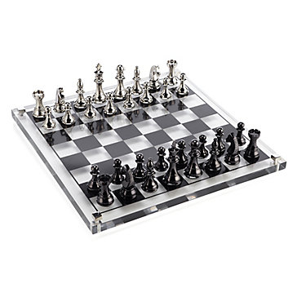
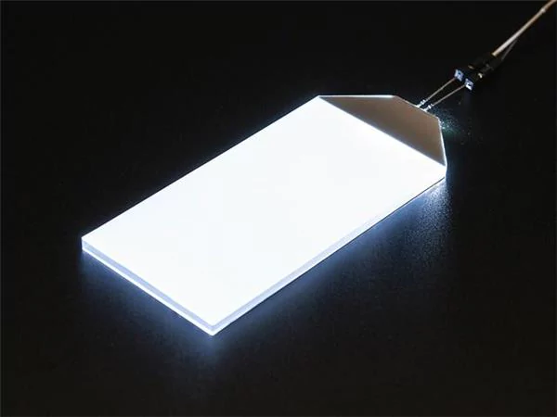
LEDs
LED edge-lit acrylic lighting
- Surface friction can be modified
- Custom sized
- Easier for the RFID scanners to read through
- Attached to metal frame to create the supporting board surface.

Slide 13
Android Application/ Microcontroller
illegalMoveDetection()
Engine to assess legality of moves before sending to opponent’s android application.
ledController()
Controls LED using MUX to select which LED to light in each row. Will help in reducing the number of traces on PCB
gameLogic()
checkmates, draw conditions, three-fold repetitions, and castling problems
chessBoardUI()
Design simple to use UI to display moves

Slide 14
Budget
Microcontroller: $2-$12
RFID Tags: $15
RFID Readers: $2(x64)
PCB: ~$30
LED: <$2(x64)
Raw Materials: $10
BT Module: $8
Total: ~$350

Slide 15
MDR Deliverable
Detection of piece movement within a 3x3 grid and transmitting information to a mobile phone. Assembly of LED and Sensor Array(David, Battsooj)
Software Skeleton and Microcontroller(Shashwat)
Demonstrates:
Accurate detection of unique piece ID
Detecting the removal and placing of pieces within a 3x3 grid
Relaying information to Android Application

Slide 16
Questions

Slide 17
Q&A
Would people actually buy it?
Ans: YES! Square-Off chess was funded in only 3 weeks, and being sold by 250$ per board on indiegogo.com.

Slide 18
Q&A
Chess equipment standard?
US Chess Federation has established Tournament
Sizing Standard.
“The 75% Guideline”.

